Slide 1

Chapter 2
Variables, Research Process and Research Problem

Slide 2
Variable
A variable is a characteristic or attribute that can take different values.
Examples:
Age
Income
Job satisfaction
Employee performance
Education

Slide 3
Types of Variables
1. Independent Variable: An independent variable (IV) is a variable that is proposed to influence or explain another variable.
Example:
Employee Training → Employee Performance
Here:
Employee Training = Independent Variable

Slide 4
Types of Variables (cont.)
2. Dependent Variable: A dependent variable (DV) is the outcome variable that is expected to be influenced by another variable.
Example:
Employee Training → Employee Performance
Here:
Employee Performance = Dependent Variable

Slide 5
Types of Variables (cont.)
A mediator explains how or why an independent variable affects a dependent variable.
Example:
Leadership → Psychological Empowerment → Employee Performance
Here:
Leadership = IV
Psychological Empowerment = Mediator
Employee Performance = DV
The mediator explains the mechanism through which leadership may influence performance.

Slide 6
Types of Variables (cont.)
4. Moderating Variable: A moderator changes the strength or direction of the relationship between two variables.
Example:
Leadership → Employee Performance
Suppose employee experience changes the strength of this relationship.
Then:
Employee Experience = Moderator

Slide 7
Hypothesis
A hypothesis is a tentative, testable statement about a relationship between variables.
Example:
H1: Employee training has a positive effect on employee performance.
A hypothesis should be capable of being tested using empirical evidence.

Slide 8
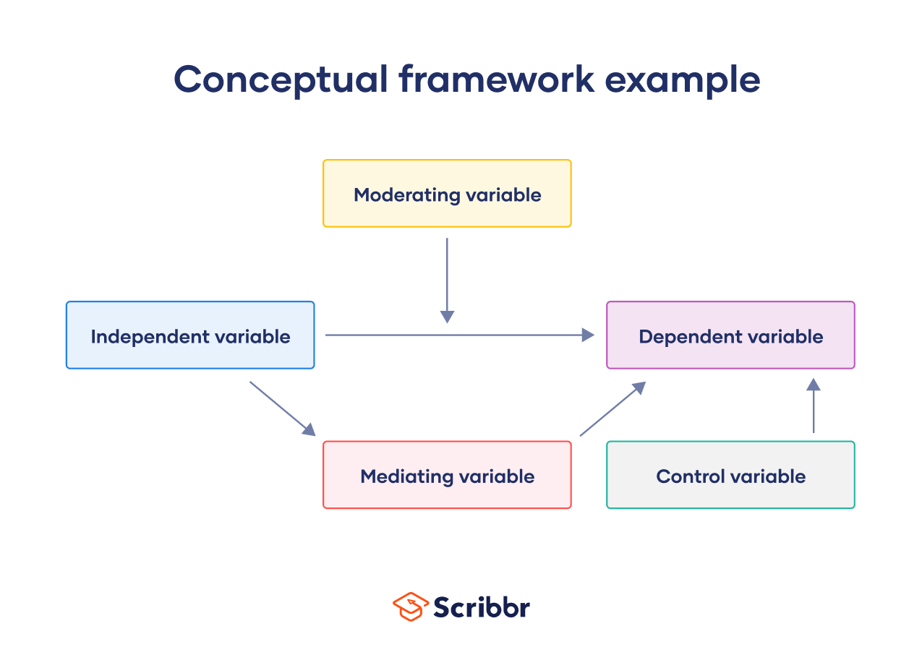
Model / Conceptual Framework
A conceptual framework represents the expected relationships among variables in a research study.
Example:
Employee Training → Employee Motivation → Employee Performance

Slide 9
Research Process
Identify the Research Problem – Identify the issue, gap, or question to be investigated.
Review the Literature – Study previous research to understand existing knowledge and identify research gaps.
Develop Research Questions or Hypotheses – Define what the research aims to find out and develop testable statements.
Develop the Research Framework – Identify the key variables and their expected relationships.

Slide 10
Research Process (Cont.)
Determine the Sample – Decide who will participate, how many participants are needed, and how they will be selected.
Collect Data – Gather relevant information through questionnaires, interviews, observation, experiments, or other methods.
Analyze the Data – Use appropriate statistical techniques to analyze the collected data.
Present Findings and Recommendations – Explain the results and provide conclusions and recommendations based on the findings.

Slide 11
Research Problem
A research problem is a specific issue, difficulty, unanswered question, or knowledge gap that a researcher wants to investigate systematically.
Example
Suppose a company has experienced a high employee turnover rate.
The general issue is:
Employees are leaving the organization.
A research problem could be:
The organization does not clearly understand how job stress and lack of organizational support contribute to employees' intention to leave.

Slide 12
Sources of Research Problems
1. Existing Literature: Previous studies may identify areas that have not yet been adequately investigated. Example: Previous studies have examined leadership and employee performance, but very few studies have examined this relationship in Bangladesh's hospitality industry.
2. Practical Problems: Real-world organizational or social problems can create research problems.

Slide 13
Sources of Research Problems
3. Personal Observation or Experience: Researchers may identify problems through their own observations. Example: A researcher notices that employees in an organization are frequently absent and decides to investigate the possible causes.
4. Social and Economic Changes: Changes in society, technology, economy, and business can create new research problems.

Slide 14
Characteristics of a Good Research Problem
1 Clear: The problem should be easy to understand. For Example:
2 Specific: The problem should not be unnecessarily broad.
3 Researchable: The problem must be possible to investigate using appropriate research methods and data.
4 Relevant: The problem should have academic, practical, social, or managerial importance.

Slide 15
Characteristics of a Good Research Problem
5 Feasible: The researcher should have sufficient: Time, Money, Data, Skills, Resources
6 Ethical; The research should be possible without violating participants' rights, privacy, dignity, or safety.
7 Original or Valuable: The study should contribute something useful rather than simply repeating an existing study without justification.
8 Significant: The problem should matter to someone

Slide 16
Thank You

